Slide 1



Performance-based FGS Engineering
ISA TR 84.00.07-2018
Webinar
Version 2018 – r5
Copyright © Kenexis Consulting Corporation, All Rights Reserved

Slide 2



Presenter Introduction
Kevin Mitchell, PE, ISA84 Expert
Vice President, Kenexis
20 Years Experience
ISA Committees - S84,
Co-Chair WG7 Fire and Gas
BSChE, University of Minnesota
ISA84 Expert

Slide 3
Safety Life-cycle 61511
Hazard and Risk Assessment
Clause 8
Management of Functional Safety
Functional Safety Assessment
Auditing
Safety Life-cycle Structure and Planning
Verification
Allocation of Safety Functions
to Protection Layers, Clause 9
Safety Requirements Specification
for the Safety Instrumented System
Clauses 10
Design and Engineering
Of Safety Instrumented System
Clauses 11, 12 and 13
Design and Development
Of Other Means of Risk Reduction
Clause 9
Installation, Commissioning, and Validation
Clauses 14 and 15
Operation and Maintenance
Clause 16
Modification
Clause 17
Clause 6.2
Clauses 7, 12.5
Clause 5
Decommissioning
Clause 18
Notes:
Nearly identical to Ed 1.0 safety life-cycle

Slide 4
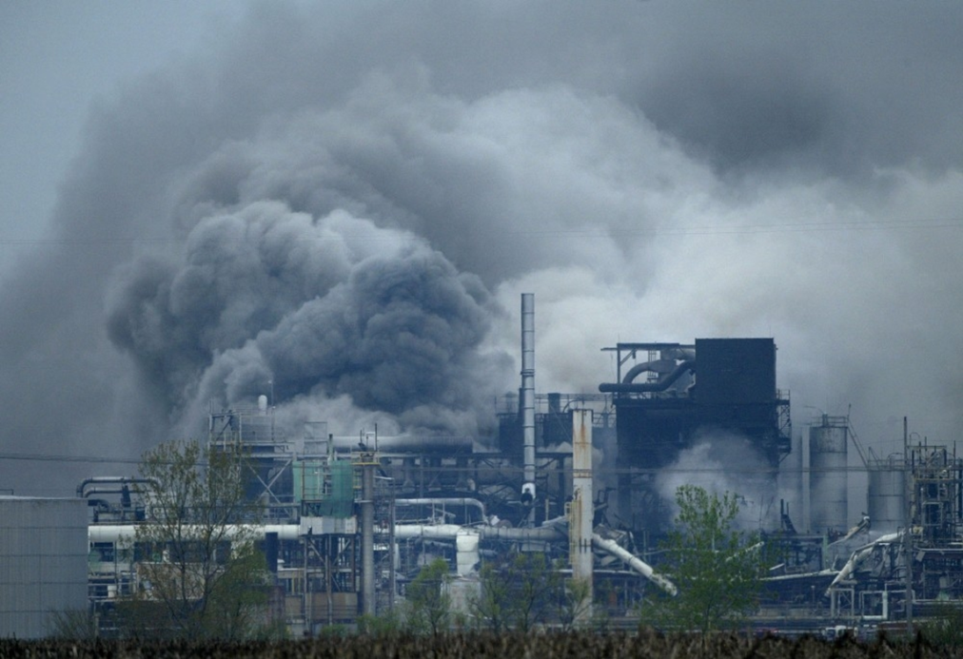
Fire & Gas Systems (FGS)
Challenges for Engineers
Widely Used but difficult to develop standards
History is Rules of Thumb or Engineering Heuristics
Two Common Problems Historically
  unable to detect hazards due to an insufficient number or poorly located detectors
    Inadequate methods for evaluating coverage of detector arrays
  Relatively high frequency of spurious activation
    Many FGS systems / alarms are bypassed or ignored
4
© Kenexis Consulting Corporation – 2018
Notes:
Should I just consider FGS as another Independent Protection Layer (IPL) in LOPA?
Be careful when Risk Analysis for compliance with ISA / IEC 61511 Standard for SIS
FGS “Mitigates” Hazard Severity
FGS Does not “Prevent” a Hazard
Detector Placement and Coverage can’t be ignored
UK/HSE data indicate more than 30% of major gas releases are not detected by automated systems

Slide 5

Performance-Based FGS Guidelines
ISA TR 84.00.07 Provides guidance for FGS design in accordance with the principles of ISA / IEC 61511
  Specify and Verify Performance Targets
  F&G Mapping for Coverage
  Written specifically for
  process industry
  Not intended as replacement for
  prescriptive design codes;
  intended as supplement

Slide 6
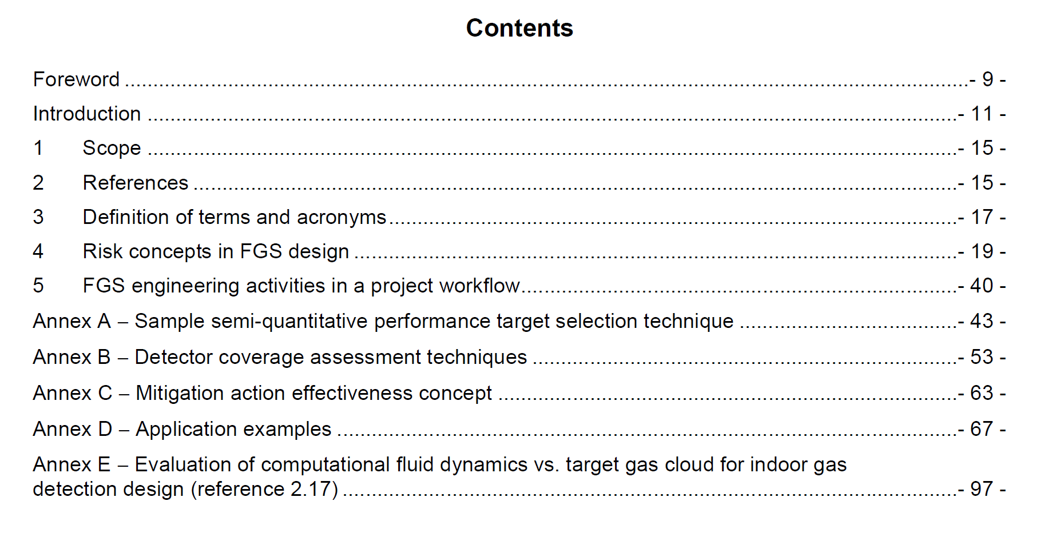
TR 84.00.07-2018
Guidance on the Evaluation of Fire,
Combustible Gas, and Toxic Gas System Effectiveness

Slide 7
FGS Risk Reduction
Frequency per year
Category 1
Minor Injury
Category 2
Moderate Injury
Category 3
Severe Injury
Category 4
Single Fatality
Category 5
Multiple Fatality
V. High
Optional
Optional
Action at Next Opportunity
Immediate Action
Immediate Action
10⁻⁰
Early-Stage Hazard with Potential for Hazard Escalation
High
Optional
Optional
Optional
Action at Next Opportunity
Immediate Action
10⁻¹
Md. High
No further action
Optional
Optional
Action at Next Opportunity
Action at Next Opportunity
10⁻²
Med.
No further action
No further action
Optional
Optional
Action at Next Opportunity
Unmitigated
Risk
10⁻³
FGS Mitigated
Risk
Md. Low
No further action
No further action
No further action
Optional
Optional
10⁻⁴
Low
No further action
No further action
No further action
No further action
Optional
10⁻⁵
Remote
No further action
No further action
No further action
No further action
No further action
10⁻⁶
Note: these are only example risk tolerance guidelines
Notes:
Risk Matrix way to represent societal risk. Similar to F-N representation.
As consequence severity increases to multiple persons, our aversion to risk becomes higher, and we would require more risk reduction to make that a tolerable situation.

Slide 8
FGS Benefits – Fire Detection
Risk Factor | Unmitigated Fire | Mitigated Fire
Fire Detection Performance | Delayed detection or no action taken | Early detection and rapid action taken
Quantity Released | Limited only by fuel in process or human intervention | Reduced with automatic ESD
Fire Duration | Extended | Limited with automatic ESD
Fire Intensity | Inherent to fuel | Suppressed by deluge
Escalation | Potential flame impingement on process equipment | Minimized by ESD and Suppression
Life Safety Impact | Delayed evacuation, potential blocked escape | Improved opportunity for early egress and escape
Notes:
Make note of this slide. You will come back to it for reference later.

Slide 9
FGS Benefits – Gas Detection
Risk Factor | Unmitigated Gas Release | Mitigated Gas Release
Gas Detection Performance | Delayed detection or no action taken | Early detection and rapid action taken
Quantity Released Size of Gas Cloud | Limited only by fuel in process or human action | Reduced with automatic ESD and depressuring
Ignition Potential | Inherent to process environment | Minimized with ESD and electrical de-energization
Vapor Cloud Explosion Potential | Large accumulation possible | Minimized with automatic ESD and depressuring
Life Safety Impact | Delayed evacuation, potential blocked escape | Improved opportunity for early egress and escape

Slide 10
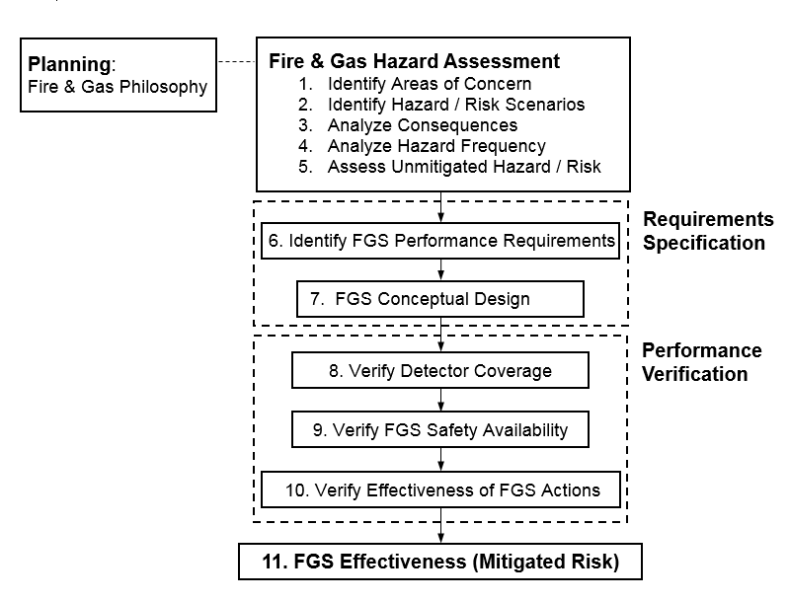
Fire and Gas Design Process
Consistent with the
underlying principles of
ISA / IEC 61511
Developed for
Process Plant Applications
Performance-based Engineering

Slide 11
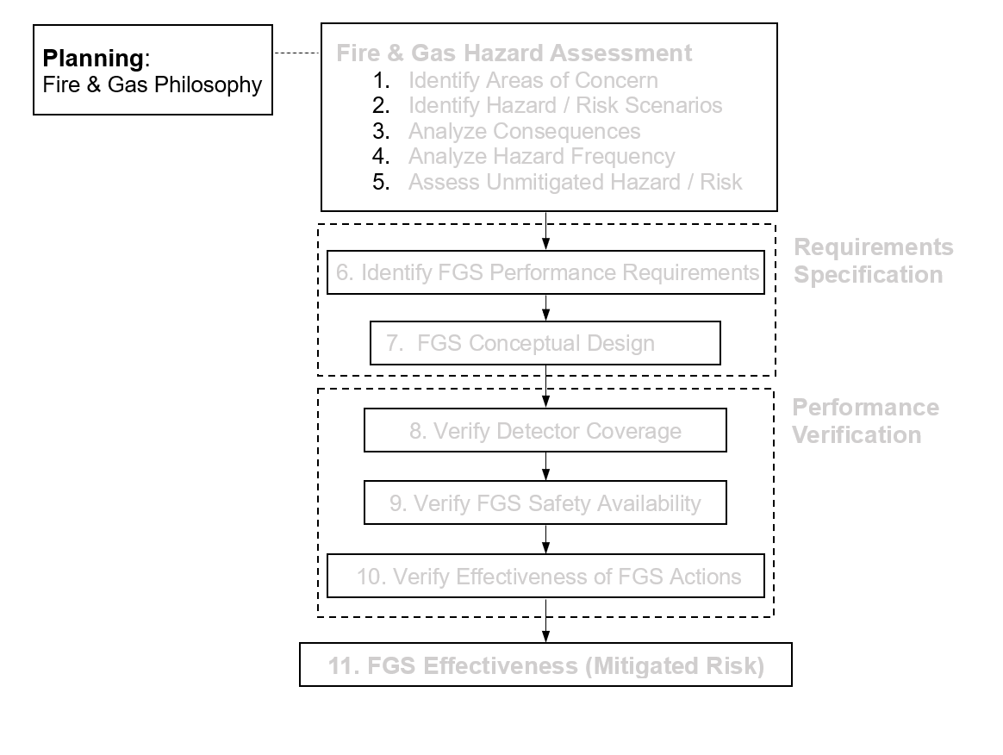
Fire & Gas System
Engineering Lifecycle and Design Process

Slide 12
Fire Detection Philosophies
Fire Detection Philosophy | Elements of Philosophy Decision | Typical Application
Goal is to detect fire as early as practical to reduce the possibility of escalation, minimize impact to the asset, and allow personnel to take appropriate protective actions. | Within a monitored process area: Detection: Incipient fire Successful FGS mitigation prompt evacuation or shelter-in-place response to alarm notification isolate fuel source depressurize the process initiate fixed fire suppression of affected equipment and surrounding equipment | Occupied offshore facilities High-value assets Onshore process plants with significant occupancy
 | Migration beyond monitored process area: Detection: Smoke at building air intakes Successful FGS mitigation: prompt evacuation or shelter-in-place response to alarm notification shutdown ventilation | Occupied offshore facilities
Goal is to detect fire that has the potential to produce major damage beyond the area of origin to mitigate against total asset loss. | Within a monitored process area: Detection: Fully developed fire Successful FGS mitigation isolate fuel source and allow to extinguish by depletion of fuel | Normally unmanned installations, onshore or offshore, with limited firefighting capability
 | Migration beyond monitored process area: Detection: (none)

Slide 13
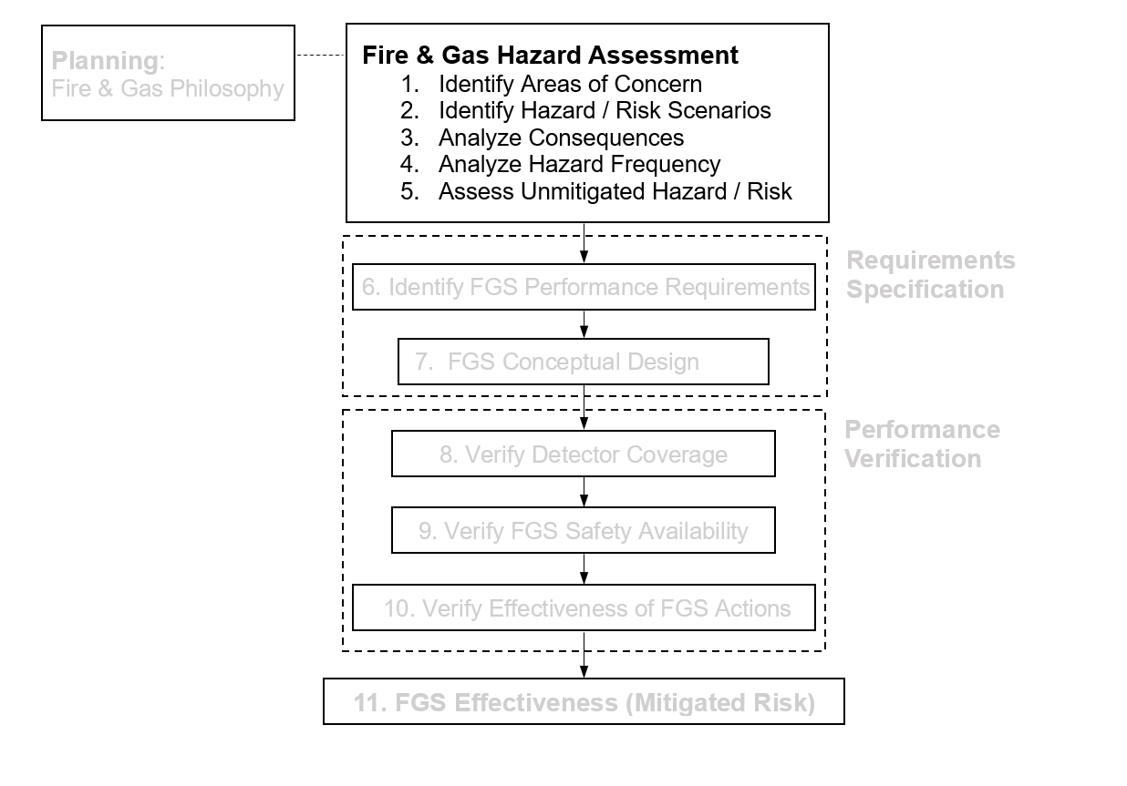
Fire & Gas System
Engineering Lifecycle and Design Process

Slide 14
FGS Risk Reduction
Frequency per year
Category 1
Minor Injury
Category 2
Moderate Injury
Category 3
Severe Injury
Category 4
Single Fatality
Category 5
Multiple Fatality
V. High
Optional
Optional
Action at Next Opportunity
Immediate Action
Immediate Action
10⁻⁰
Early-Stage Hazard with Potential for Hazard Escalation
High
Optional
Optional
Optional
Action at Next Opportunity
Immediate Action
10⁻¹
Md. High
No further action
Optional
Optional
Action at Next Opportunity
Action at Next Opportunity
10⁻²
Med.
No further action
No further action
Optional
Optional
Action at Next Opportunity
Unmitigated
Risk
10⁻³
FGS Mitigated
Risk
Md. Low
No further action
No further action
No further action
Optional
Optional
10⁻⁴
Low
No further action
No further action
No further action
No further action
Optional
10⁻⁵
Remote
No further action
No further action
No further action
No further action
No further action
10⁻⁶
Note: these are only example risk tolerance guidelines
Notes:
Risk Matrix way to represent societal risk. Similar to F-N representation.
As consequence severity increases to multiple persons, our aversion to risk becomes higher, and we would require more risk reduction to make that a tolerable situation.

Slide 15
Application of ISA TR 84.00.07
FGS Performance Metrics
FGS performance targets should be consistent with the end-user philosophy for hazard detection and mitigation, based on the level of hazard and risk associated with process hazards in a monitored area.
Achievement of FGS performance targets should be through application of one or more of the listed FGS performance metrics.
  FGS Detector Coverage
  FGS Safety Availability
  Mitigation Action Effectiveness
 | FGS Detector Coverage | FGS Safety Availability | FGS Mitigation Effectiveness |  | Relative Likelihood | Outcome
 |  | Yes | 0.9 |  | 0.70 | Mitigated
 | Yes | 0.97
 | 0.8 |  | 0.1 |  | 0.08 | Unmitigated
Design Basis Hazard |  | No
1 |  | 0.03 |  |  | 0.02 | Unmitigated
 | No
 | 0.2 |  |  |  | 0.20 | Unmitigated
 |  |  | FGS Effectiveness |  | 0.70

Slide 16
Definitions
Term | Definition | Notes
FGS Detector Coverage | The confidence that the hazard will be detected | Hazard within the basis-of-design Detector (Geographic) Coverage Detector (Scenario) Coverage
FGS Safety Availability | The availability of the FGS Function that is designed to automatically mitigate the severity of the hazard | One minus the probability of failure on demand (PFDavg) for the FGS Function
Mitigation Action Effectiveness | The confidence that the final element(s) actions will successfully mitigate the severity of the hazard defined in the FGS basis of design. | Confidence could be highly dependent on the magnitude of the initial event, and/or how early it is detected / acted upon

Slide 17
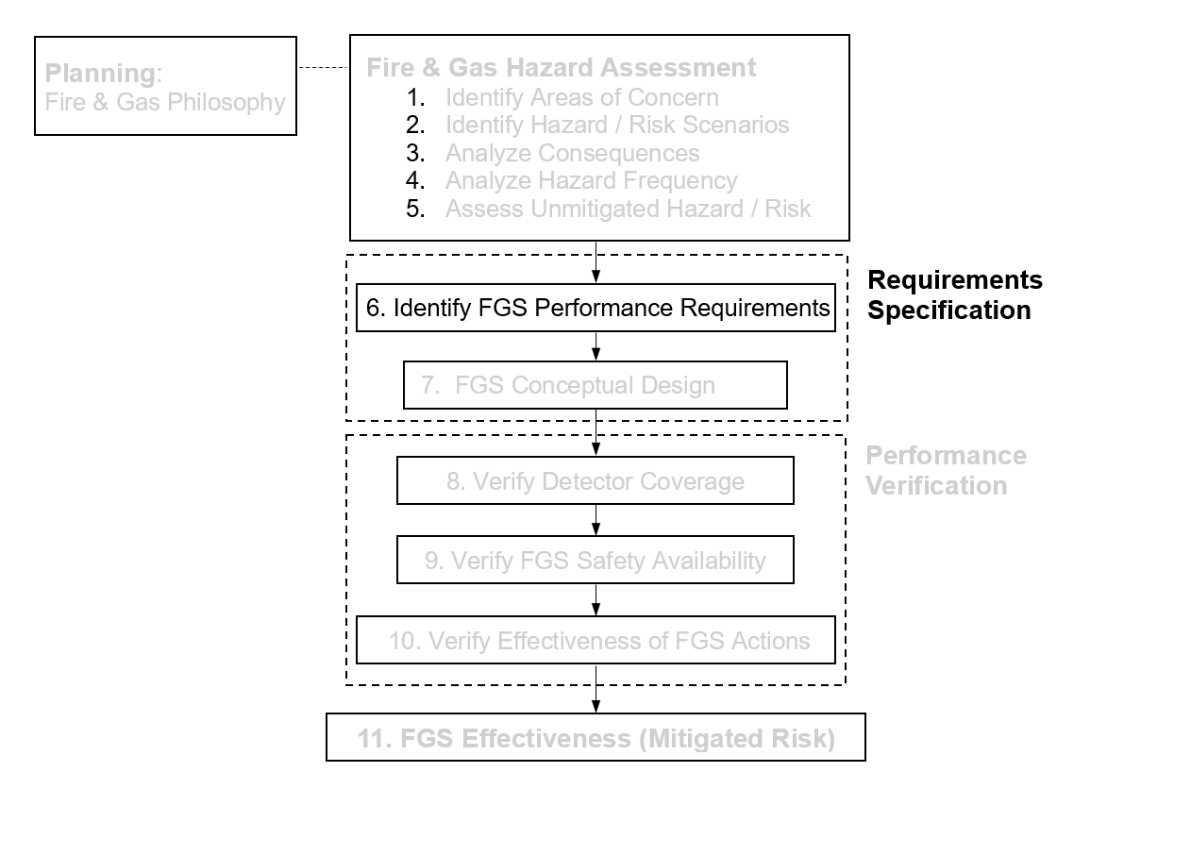
Fire & Gas System
Engineering Lifecycle and Design Process

Slide 18
Application of ISA TR 84.00.07
Performance Metric | Expression | Recommended Application
Detector Coverage (FGS Mapping) | Quantitative: Probability | Applications with any claimed FGS Risk Reduction Factor where safety objective is to reduce escalation of early-stage hazard
Safety Availability | Qualitative Confirmation | Applications where claimed FGS Risk Reduction Factor < = 10
 | Quantitative: Probability | Applications where claimed FGS Risk Reduction Factor > 10
Mitigation Action Effectiveness | Qualitative Confirmation | Mitigation Applications where claimed FGS Risk Reduction Factor < = 10
 | Quantitative: Probability | Mitigation Applications where claimed FGS Risk Reduction Factor > 10

Slide 19
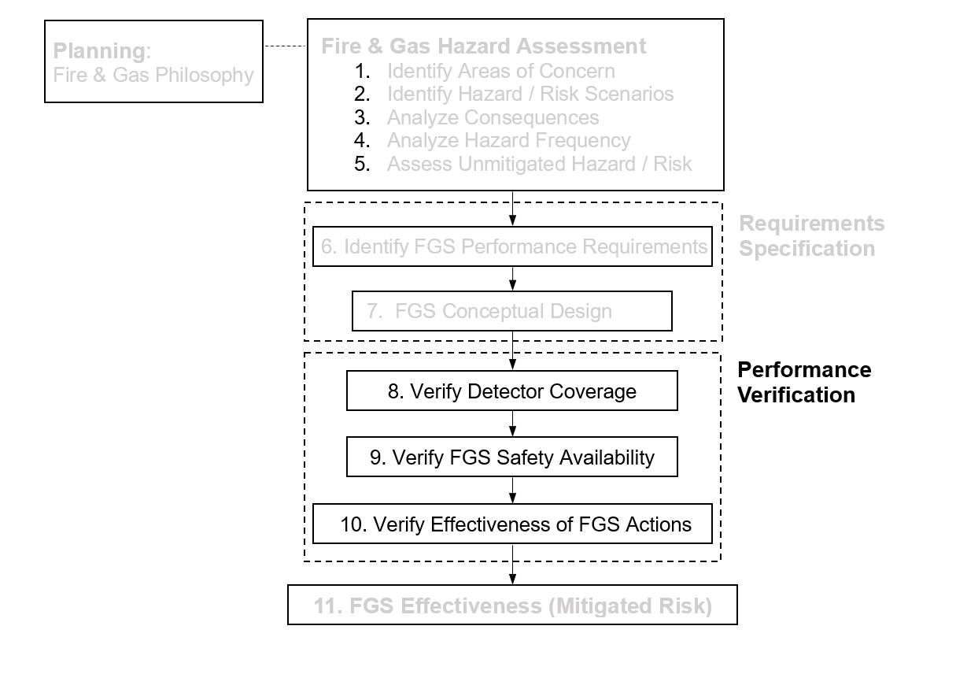
Fire & Gas System
Engineering Lifecycle and Design Process

Slide 20
Application Examples
FGS Example | Risk Reduction Claim | Applicable Stds. for Functional Safety | Performance Metrics
Fire (heat) detection on petrol truck loading bay causes shutoff of loading pump & activates CO2 fire extinguishing agent | Non Specific Risk Reduction Claim | Application-specific standards from local Jurisdiction Having Authority (discretion of user) | (discretion of user)
Area-wide fire (flame) detection in oil separation plant causes ESD and firewater deluge | FGS RRF < = 10 | ANSI/ISA-84.91.01 TR 84.00.07-2018 | Coverage | Quantitative · Fire Mapping
 |  |  | Availability | Qual. Confirm.
 |  |  | Mitig. Effective | Qual. Confirm.
Area-wide flammable gas detection on offshore natural gas production platform causes ESD | FGS RRF < = 10 | ANSI/ISA-84.91.01 TR 84.00.07-2018 | Coverage | Quantitative · Gas Mapping
 |  |  | Availability | Qual. Confirm.
 |  |  | Mitig. Effective | Qual. Confirm.
Toxic (HF) gas detection for acid circulation pump isolates pump and activates pump deluge | FGS RRF > 10 | ANSI/ISA-84.91.01 TR 84.00.07-2018 ISA / IEC 61511 | Coverage | Quantitative · Gas Mapping
 |  |  | Availability | Quantitative ISA/IEC 61511
 |  |  | Mitig. Effective | Quantitative

Slide 21
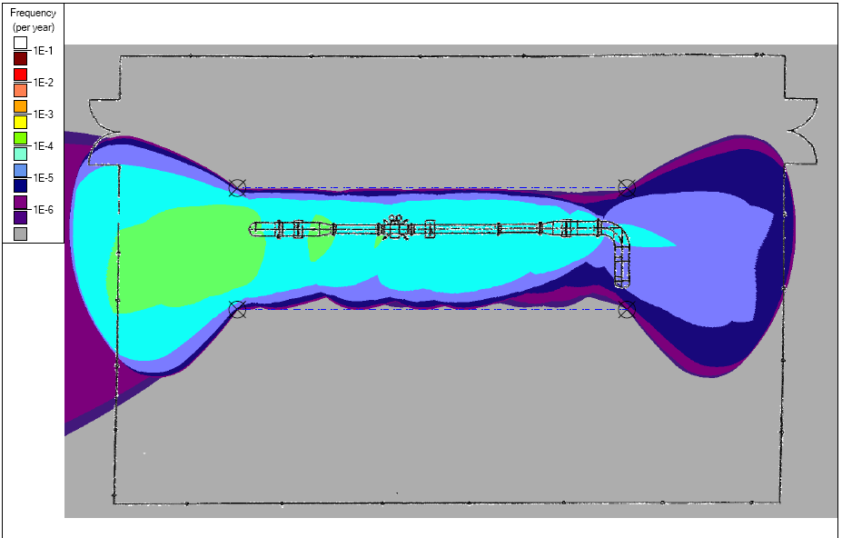
F&G Mapping
Geographic Fire Detector Coverage
Scenario-Based Geographic Risk
Geographic Gas Detector Coverage
Scenario-Based Coverage

Slide 22
Detector Geographic Coverage
Geographic Fire Detector Coverage
70% Coverage
Geographic Gas Detector Coverage
85% Coverage
Notes:
Geographic look like this, outputs are in terms of % of geographic area that is “covered”
Profile for each detector showing its coverage footprint.
Overlay Profiles results in contours of how many detectors are able to sense in a given geographic area.
Don’t explain explain yellow and green here. More later.

Slide 23
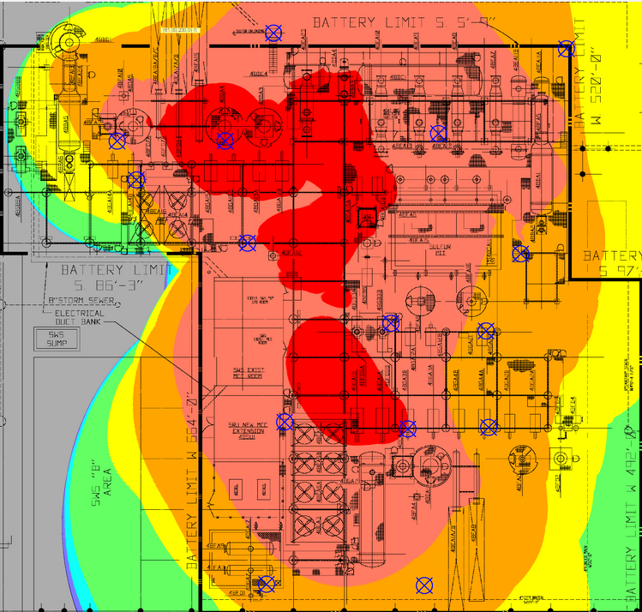
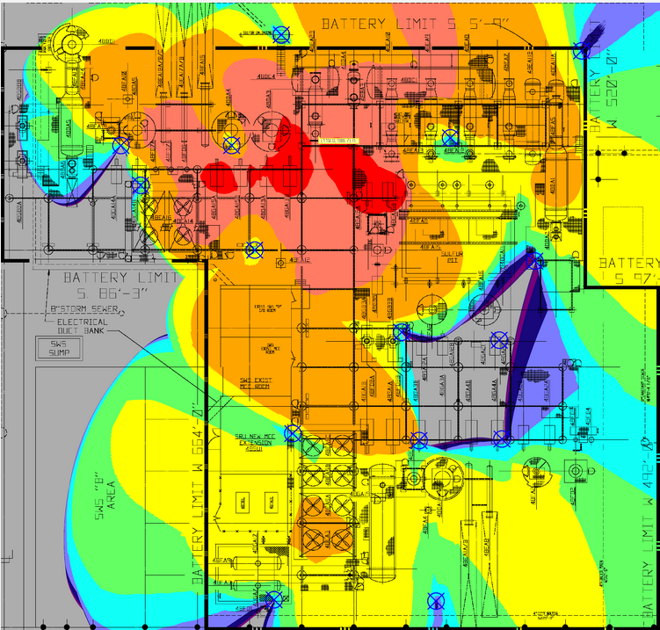
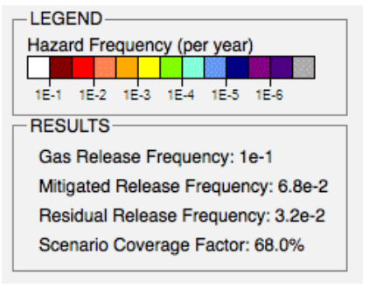
Scenario Coverage
Used for Gas Coverage (hazard scenarios) and less-frequently for Fire
Requires additional inputs about size, extent and potential location of hazards, as well as environmental conditions
23
© Kenexis Consulting Corporation – 2018

Slide 24
FGS engineering activities in a project workflow
Basic Engineering phase (FEED)
  Identify Performance Requirements
    PFD/P&IDs, PHA, Fire & Explosion Analysis (FEA)
  initial FGS design with estimates on type, number, and location of detectors required to meet the performance requirements.
  Initial confirmation of Safety Availability and Mitigation Action effectiveness
Detailed Engineering phase (EPC)
  30% process model
  60% process model, F&G Mapping
  90% process model, F&G Mapping

Slide 25
Application of ISA/IEC Standards to FGS
ISA / IEC develop standards & guidelines for safety automation.
ISA / IEC 61511: performance-based standards that provide minimum requirements for Safety Instrumented Systems (SIS).
Follows a safety lifecycle to determine functional & integrity requirements for safety functions that reduce risk of hazards, via hazard and risk analysis.
Safety functions need to be capable of achieving the allocated risk reduction. This is an underlying principle of the standards.
TR 84.00.07 provides guidance on FGS functions in a manner that is consistent with the underlying principles of ISA / IEC 61511.
FGS are safety controls, alarms, or interlocks (SCAI) that should be implemented per ANSI/ISA-84.91.01 and, if applicable, ISA/IEC 61511, based on the degree of risk reduction being claimed for an FGS Function:
CLAIM |  | RECOMMENDED IMPLEMENTATION
General FGS safeguards no specific risk reduction claimed |  | Application-specific standards from local Jurisdiction Having Authority
FGS Functions | claimed FGS risk reduction factor RRF <= 10 | Implemented per applicable requirements of ANSI/ISA-84.91.01
 | claimed FGS risk reduction factor RRF > 10 | Implemented per applicable requirements of ANSI/ISA-84.91.01 and ISA / IEC 61511

Slide 26
Fire & Gas Hazard Assessment and
Performance Requirements
Input
Task
Tools
Deliverable
F&G Philosophy
PFD / P&ID
Plot Plans
Fire & Gas
Hazard Assessment
F&G Standards
F&G Philosophy
Determine FGS
Performance Requirements
Effigy™
FGS Toolkit
F&G Mapping
Report
Effigy™
F&G Mapping
Report
Preliminary
Layout
Verify Detector Coverage
F&G Mapping
Notes:
Hazard & Risk Assessment This is where we analyze the potential for fire hazards and gas hazards to result in severe consequences, have the potential to escalate if not detected / mitigated.
The hazard & risk assessment should consider process-specific factors:
• material flammability/toxicity
• process temperature
• process pressure
• hazard frequency
• source leak size
• ignition sources
• potential for gas accumulation
• environmental conditions, such as confinement / congestion
This assessment could be qualitative, semi-quantitative (scoring), or detailed analysis/models.
This assessment could be broad & generalized such that is defined in corporate standards, or it may be very site- and process-specific.
Based on the hazard & risk assessment as well as Standards & Philosophy, performance targets can be specified. More in Section ##.

Slide 27
Verifying FGS Detector Coverage
Input
Task
Tools
Deliverable
F&G Standards
F&G Philosophy
Determine FGS
Performance Requirements
Effigy™
FGS Toolkit
F&G Mapping
Report
Effigy™
F&G Mapping
Report
Preliminary
Layout
Verify Detector Coverage
F&G Mapping
Vertigo™
FGS Design
Specifications
Consider FGS Availability
Mitigation Effectiveness

Slide 28
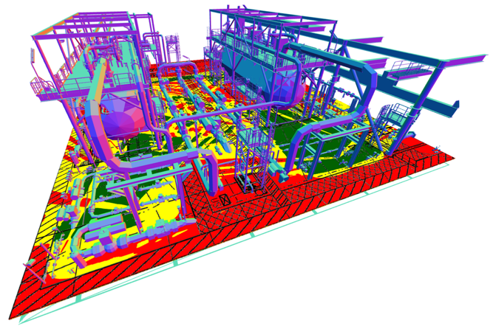

Kenexis Effigy™
3D Fire & Gas Mapping Software, Key Features
  Performance Based Quantitative Analysis Tool for Detector Placement Analysis, both Geographic and Scenario
    ISA-TR84.07-2010 Compliant
  3D CAD import &
  3D Analysis
  Accurate Optical Flame Detector Modeling
  Enterprise, Multi-User Web-Based Platform
    Always Current Tools
    Extended Team Support
28
© Kenexis Consulting Corporation – 2018

Slide 29




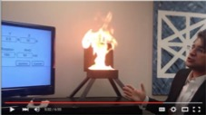
Fire & Gas Mapping Education
Kenexis
  Develop and Teach ISA EC56P Course
  ISA TR84.00.07 Authorship
  Using Effigy Online Training
  Kenexis also wrote FGS Engineering Handbook and Performance-based Fire and Gas Engineering Handbook from ISA
29
© Kenexis Consulting Corporation – 2018

